Slide 1
Network Syntax – Inter-Domain Traffic Estimation for the Outsider
Mario A. Sánchez, Fabián E. Bustamante, Bala Krishnamurthy, Walter Willinger, Georgios Smaragdakis, Jeffrey Erman
Northwestern U., AT&T Labs-Research, Niksun, MIT/TU Berlin
Notes:
Thanks Philipa, today I will present some work we haven been doing to enable the study inter-domain traffic for everyone
The only student in this great list of name – Mario Sanchez, the guy doing the work, couldn’t be here today …

Slide 2

Mario’s babysitting his newborn…
Daniella Sánchez García
Notes:
Being busy with better things; some of our collaborators did question his organization skills scheduling a baby’s birth with IMC …

Slide 3
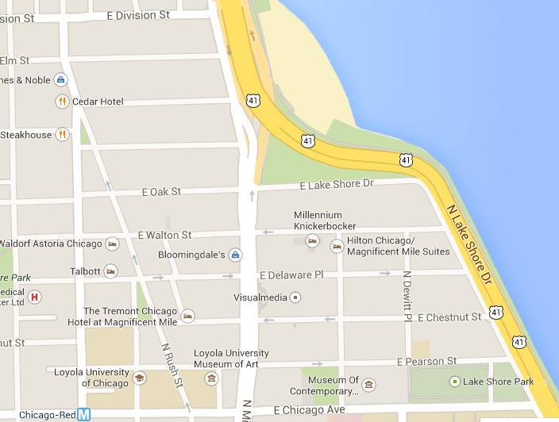

Internet inter-domain system
Most Internet inter-domain studies
Focused on network connectivity and dynamics …
Shifting focus to traffic …
Abilene
Chicago
Cogent
Level 3
~1939
Lakeshore Dr
MREN
Comcast
U Chicago
UIC
Northwestern
Michigan Ave.
Argonne
Notes:
Most Internet inter-domain studies have focused on network connectivity and dynamics, generating topologies, examining their properties

Slide 4

Inter-domain traffic studies – challenge
Traffic is all that matters …
Network engineering, anomaly detection, economics …
Challenge – few available traffic datasets
Inter-domain traffic estimation for the outsider?
Fine-grained data on a small slice
- For insiders
- Can’t reproduce - Can’t scale
Publicly available, coarse datasets
- Few - Limited scope

Slide 5
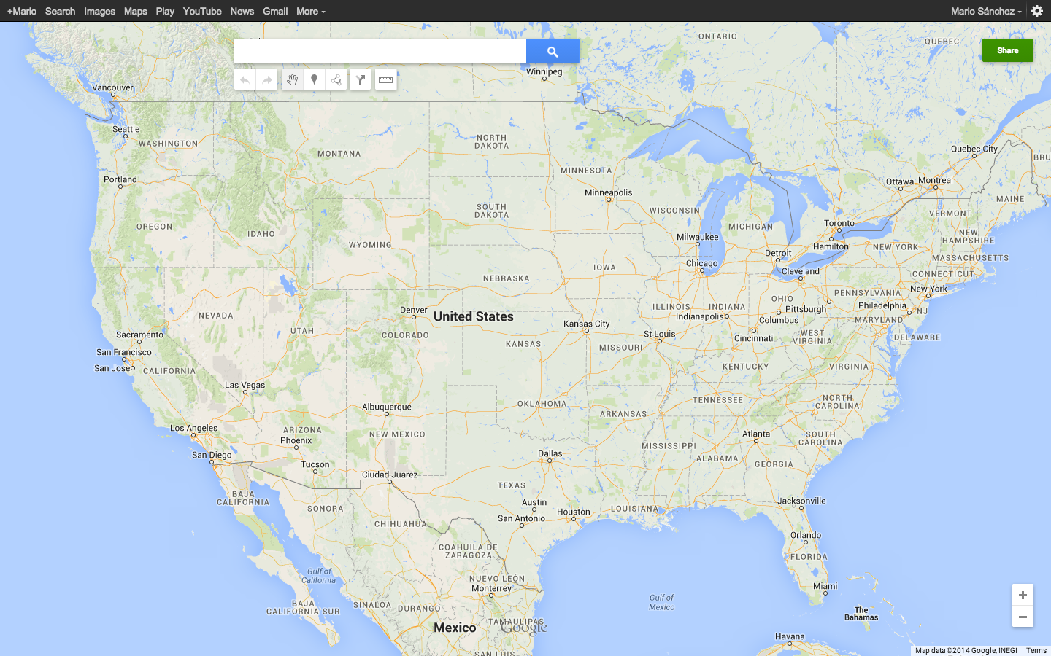
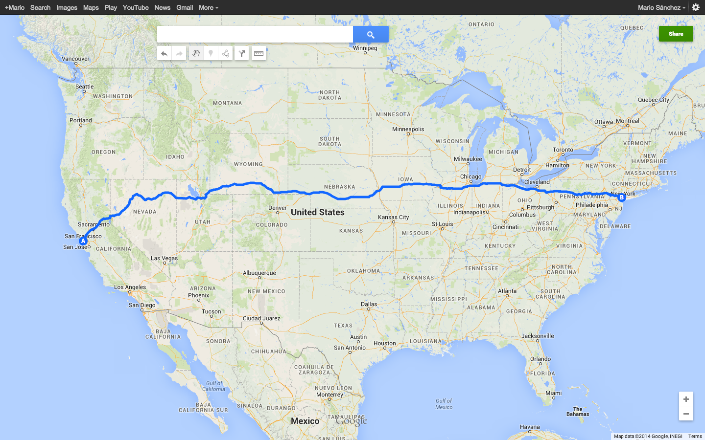
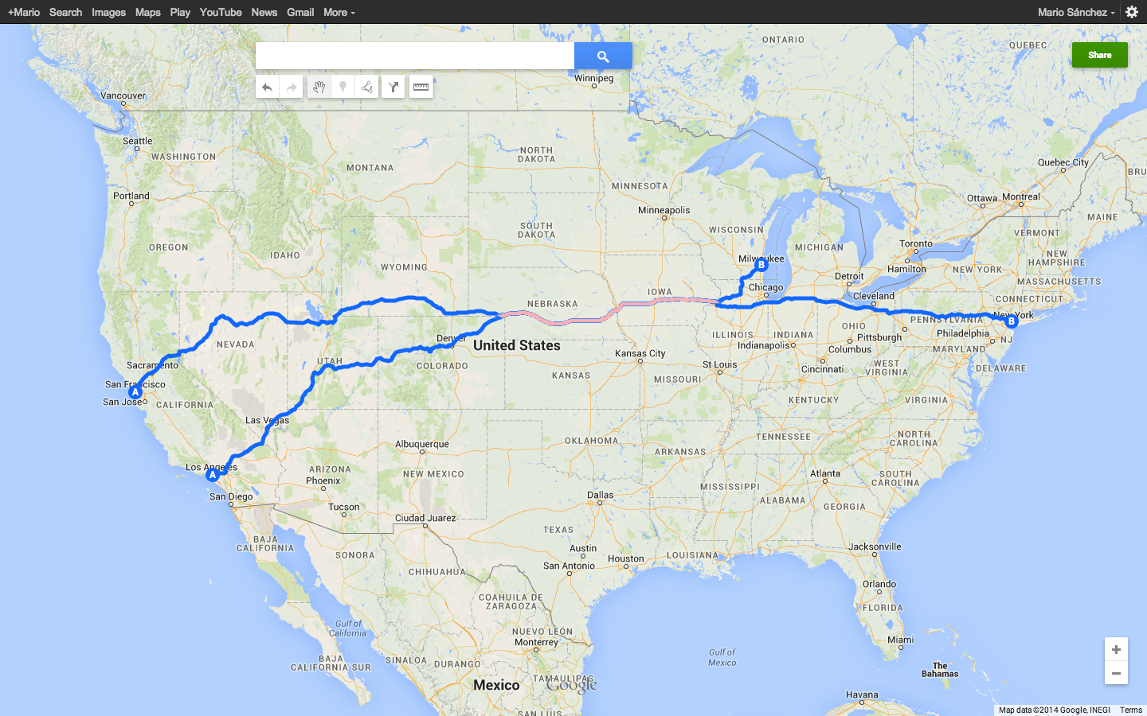
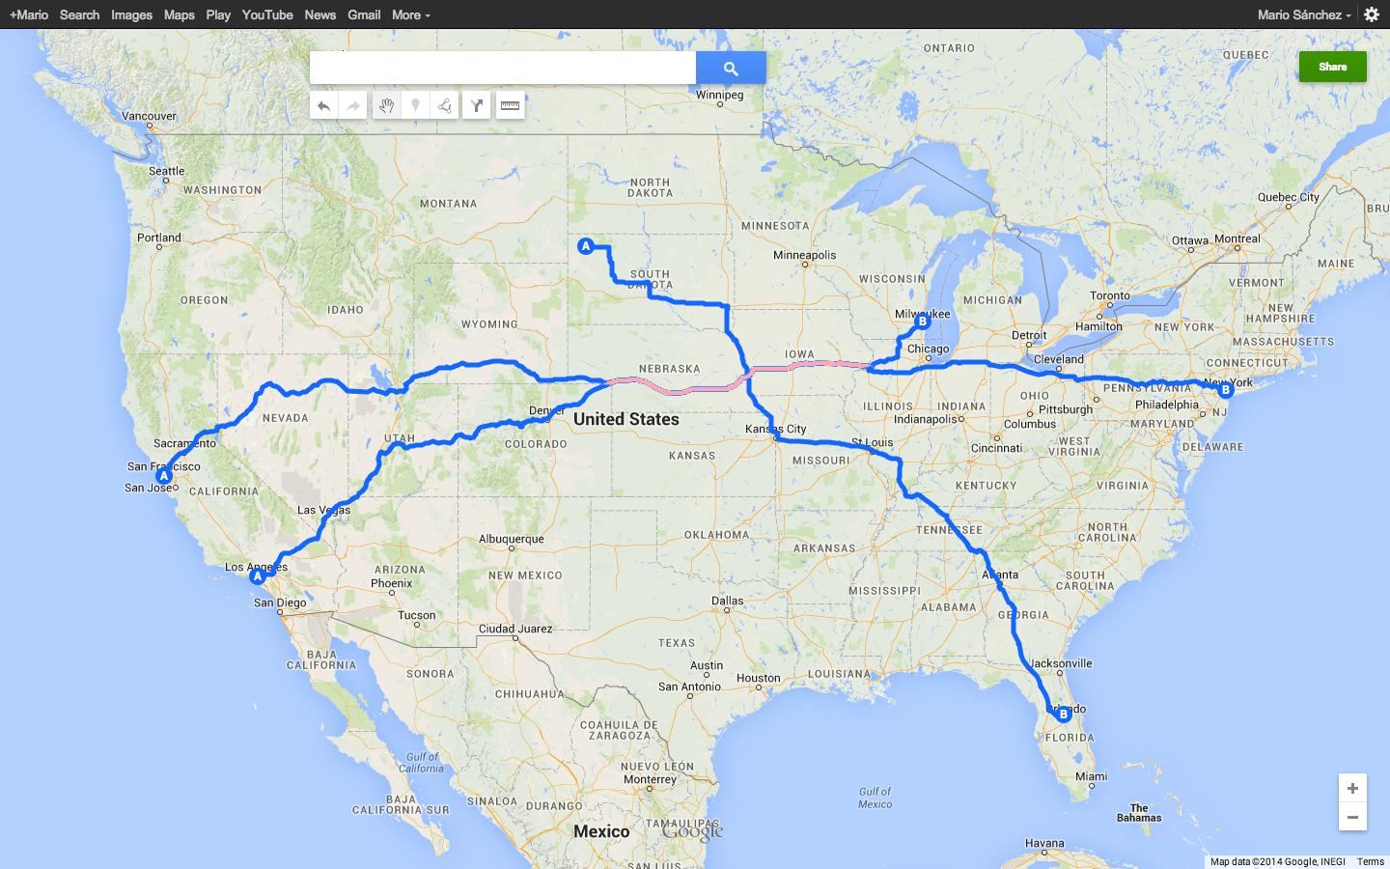
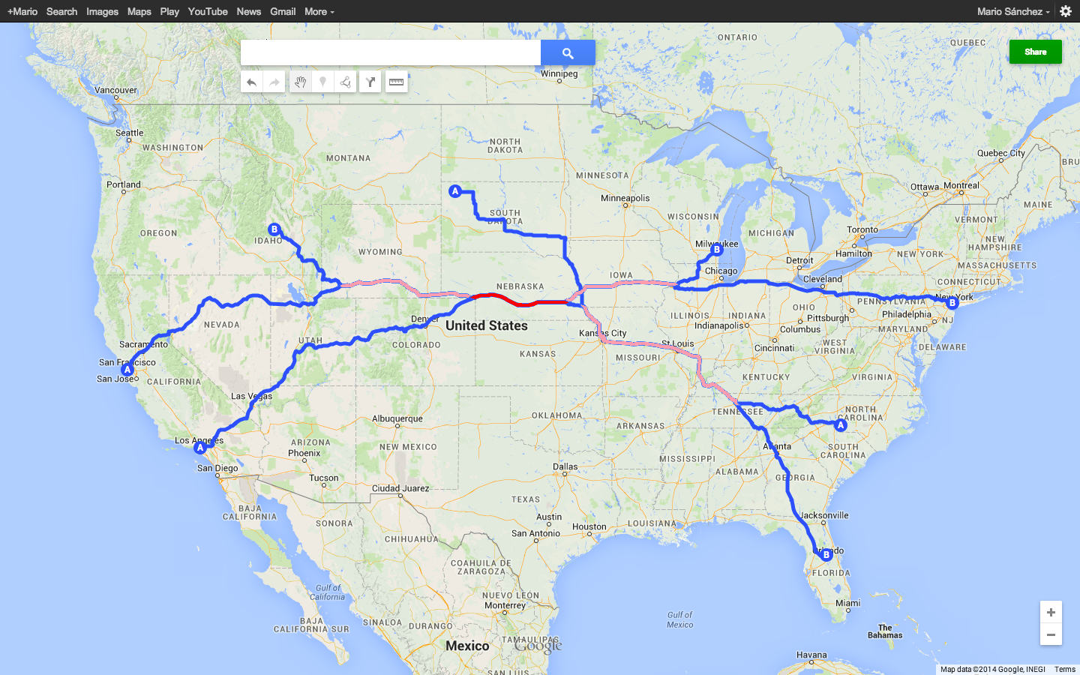
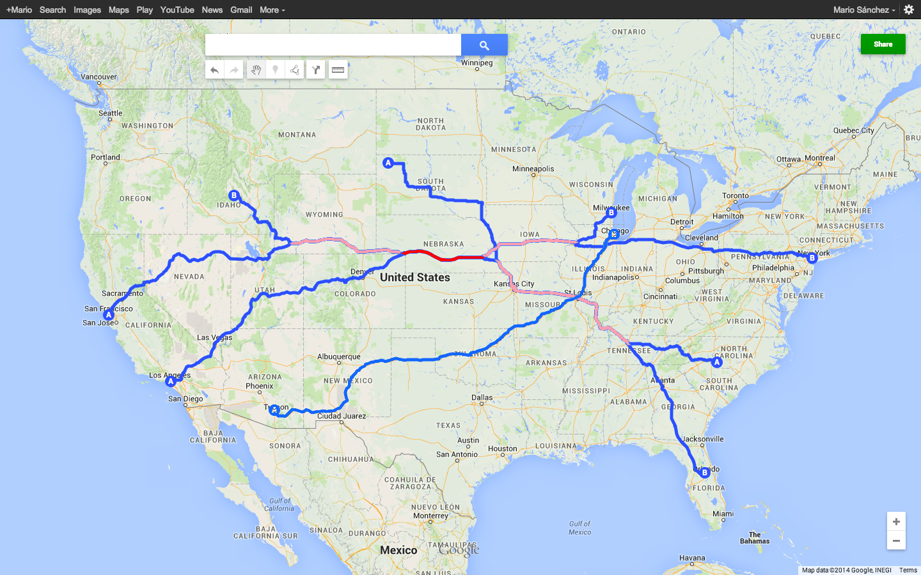

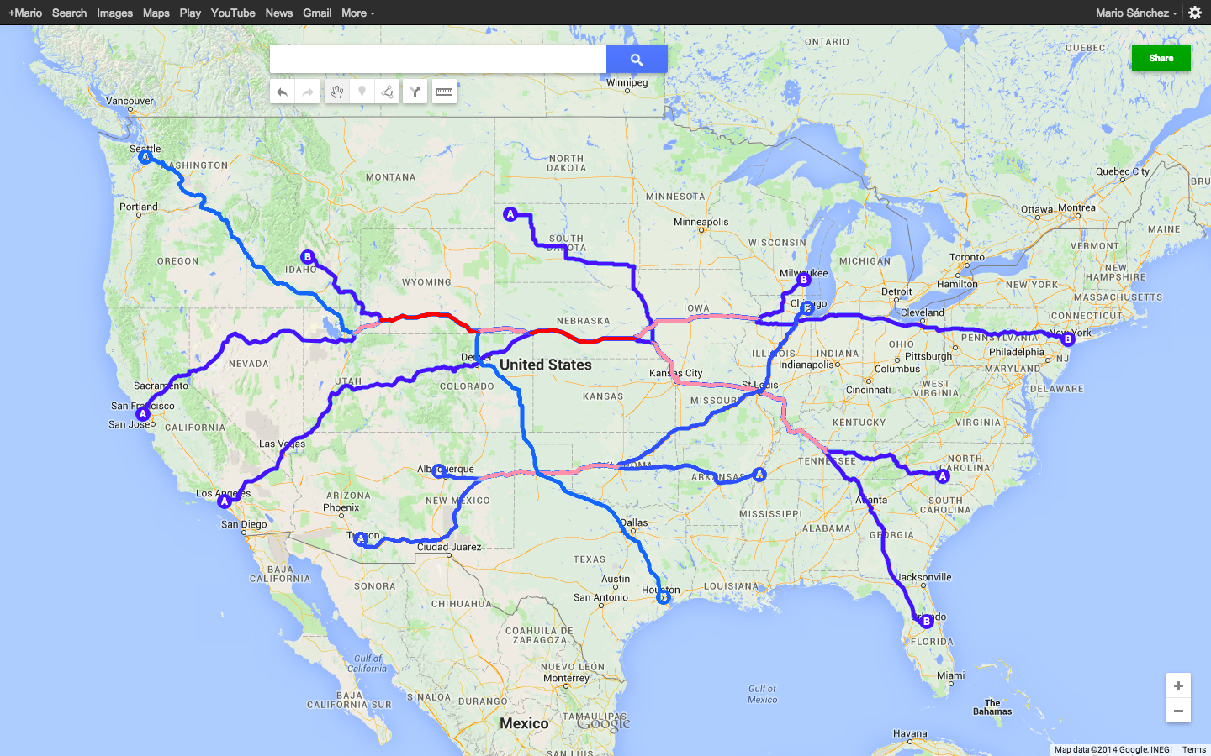
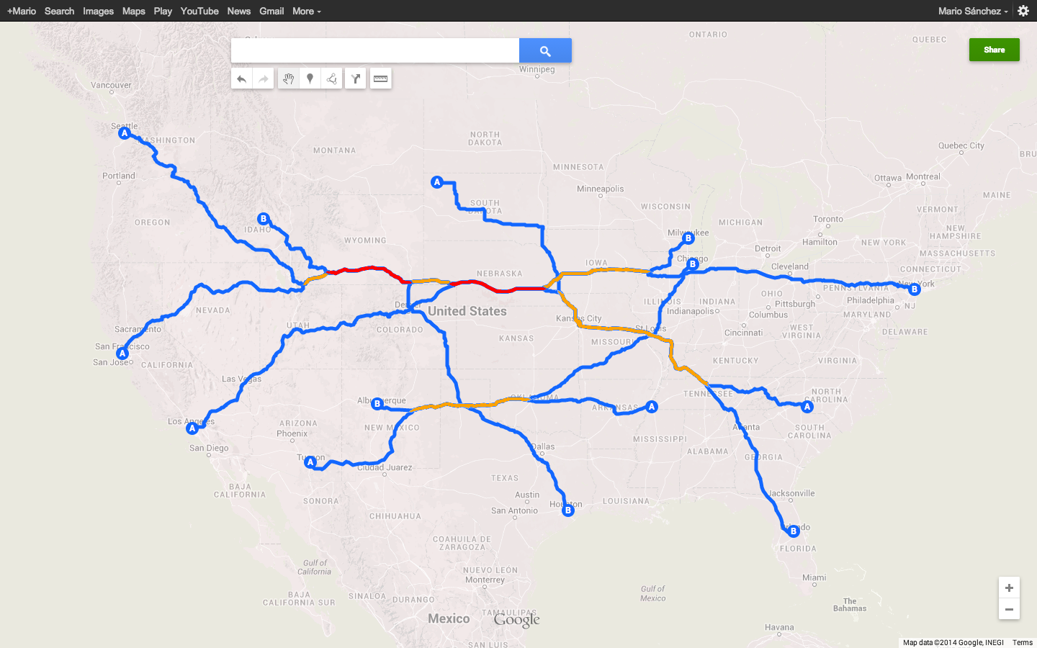
Pushing the analogy – Paths and traffic
The popularity of a route can serve as proxy for the volume of traffic it carries
Notes:
To explain the key observation behind this work, let me push a bit the road analogy …

Slide 6


Pushing the analogy – Paths and traffic
Space syntax* – from urban planning
Some streets are more central than others
Predicting path traffic based on road structure
Connectivity (dual) graph
Axial map
Central node – Node with higher connectivity
Axial line
*Hillier and Hanson, 1984
Notes:
This observation has been leverage by Hiller and Hanson, at University College London, in a methodology for Urban planning they call Space Syntax
Space syntax recognizes that some street are more central than others and use centrality metrics as proxy for human and vehicular traffic (and crime, social segregation, etc)
As a short introduction; one can look at a roadmap of a city and derive, from it, its axial map (with each axial line being the longest line of sight/access through open space). This axial map can be represented as a dual graph (with axial lines/roads as vertices) and the centrality of a given road segment can be estimated through different metrics such as connectivity (number of directly linked nodes), they found that path traffic is strongly correlated to road centrality.

Slide 7
Basic idea
Use AS-level connectivity graphs as carved by large traceroute datasets
Apply structural analysis to identify popular routes
Traceroutes tells us the route of packets
Many traceroutes let us infer popularity
Use popularity as a proxy of traffic volume
Network Syntax
Notes:
Easy-to-compute metrics of centrality/popularity
Connectivity, Global choice, Integration, Control value… (use centrality names instead???)
Robust to idiosyncrasies of traceroute dataset and measurement platforms
Degree centrality, Betweenness centrality, Closeness centrality (normalized), Clustering coefficient…

Slide 8
Network Syntax
for the outsider
Leverage existing traceroute datasets
Publicly available data, no need for special buddies
Enabling a large-scale perspective
Not just any AS-level connectivity graph
Basic AS connectivity says little about traffic (BGP)
Several centrality metrics to capture popularity
Robust to idiosyncrasies of traceroute datasets
Notes:
Easy-to-compute metrics of centrality/popularity
Connectivity, Global choice, Integration, Control value… (use centrality names instead???)
Robust to idiosyncrasies of traceroute dataset and measurement platforms
Degree centrality, Betweenness centrality, Closeness centrality (normalized), Clustering coefficient…
Idiosyncrasies like IP alias resolution and inability to trace through layer 2 clouds and the particular of the network measurement platform

Slide 9
Evaluating Network Syntax
Compute metrics from traceroute datasets
Ono campaigns April 2011 & 2013
~13M & 14M probes
1-2K sources & 12K destination Ases
Use ground-truth to check correlation to traffic
Global Tier-1 ISP – traffic exchanged with all customers
Large IXP – traffic exchanged over public peering fabric
# links | 2011 | 2013
IXP | 5.6K | 4.5K
ISP | 257 | 147
Notes:
Showing centrality metrics are good traffic proxies

Slide 10
From traceroutes to connectivity graphs
AS4
AS7
AS-link Traversing Path (ALTP) between AS5 and AS6
AS1
AS3
AS5
AS6
AS2
AS8
AS4/
AS5
AS6/AS7
Partial connectivity graph
AS1/
AS2
AS2/
AS3
AS5/AS6
AS3/
AS5
AS6/AS8

Slide 11
Network Syntax’ metrics of centrality
New and adapted metrics from Space Syntax
Two examples
Connectivity – #AS links that precede/succeed a node
ALTP-frequency – Relative cardinality of ALTP-set
AS4/
AS5
AS6/AS7
AS1/
AS2
AS2/
AS3
AS5/AS6
AS3/
AS5
AS6/AS8
Notes:
ALTP-set : unique AS-level paths traversing a link
Connectivity and ALTP-frequency, which I will use later on in my presentation

Slide 12
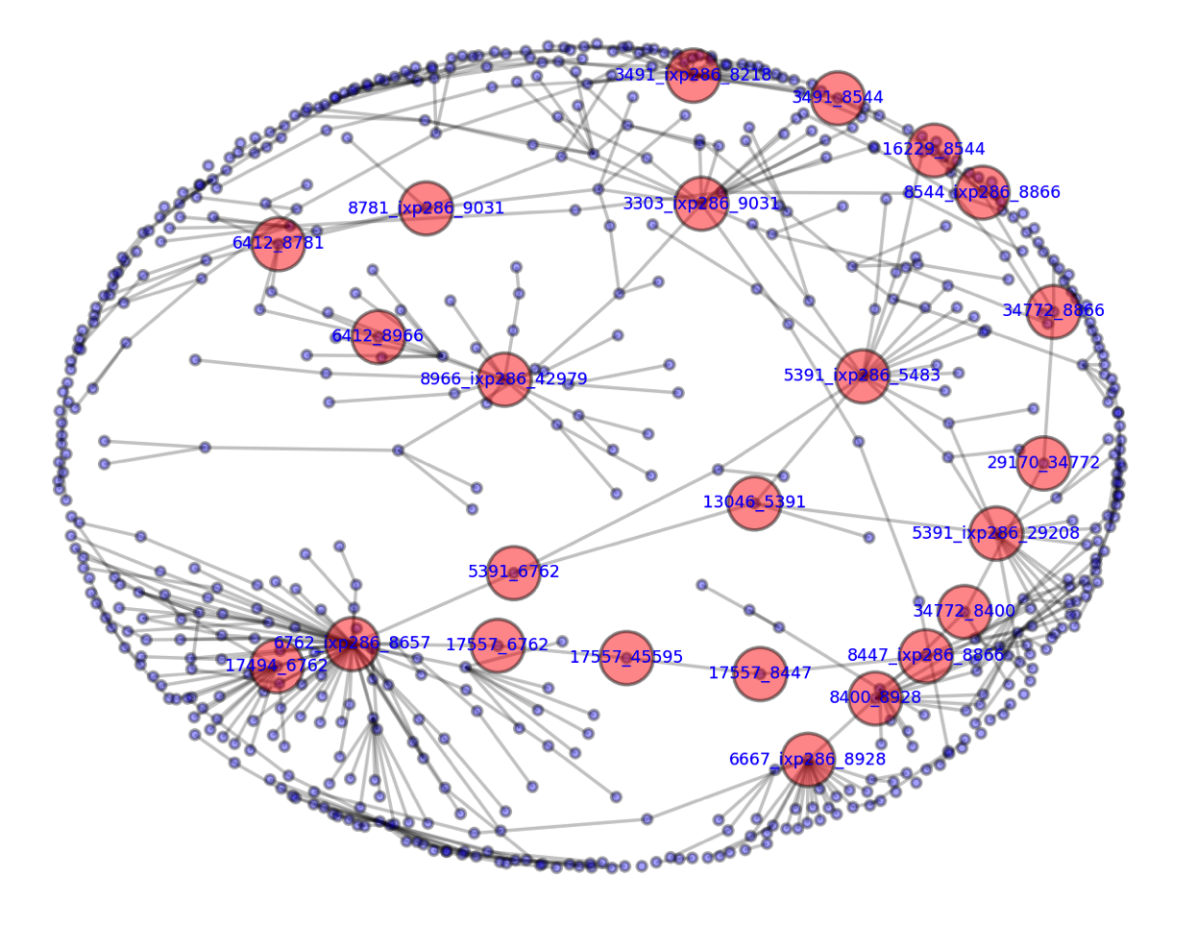
From traceroutes to connectivity graphs
Part of the IXP connectivity graph …

Slide 13
Methodology…
Generate AS-link connectivity graphs
Compute Network Syntax metrics for each AS-link
Order AS-links using each metric
Cluster links in equal-size sets to reduce noise (e.g., from sampling)
Evaluate the correlation with traffic (validation)
Apply it to; e.g. predicting missing traffic link volumes
Notes:
To reduce the potential noise on the correlations introduced by particular AS-links (e.g., due to sampling issues), we cluster links

Slide 14
Traffic and popularity – highly skewed
As most popularity measurements, long-tail distributions
Distribution of traffic for all peering in traffic matrix for IXP
Notes:
Log-normal distribution in this case
Pareto –named by Joseph Juran after Italian economist’s Vilfredo Pareto who in 1905 observed that 80% of Italian land was owned by 20% of the population

Slide 15
Traffic and popularity – highly skewed
As most popularity measurements, long-tail distributions
Transform to remedy failure of expected normality
CCDF cumulative fraction of traffic for the discovered links
Notes:
Log-normal distribution in this case
Pareto –named by Joseph Juran after Italian economist’s Vilfredo Pareto who in 1905 observed that 80% of Italian land was owned by 20% of the population

Slide 16
Let’s now look at those correlations
Correlation between centrality and traffic in both ISP and IXP
For both datasets, 2011 and 2013
Different centrality metrics
and different traceroute datasets
… this is just a sample …

Slide 17
Network Syntax – Popularity and Traffic
ISP
r²=0.789
r²=0.911
April 2011
April 2013

Slide 18
Network Syntax – Popularity and Traffic
ISP
IXP
r²=0.789
r²=0.799
April 2011
April 2011

Slide 19
Not just any AS-level connectivity graph!
ISP
From traceroutes
From BGP
r²=0.789
r²=0.399
April 2011
April 2011

Slide 20
So, what can you do with that?
Rank AS-link based on traffic volume
To check – rank AS-link based on traffic using ground-truth data, look at the correlation
Predict link traffic
Use (different) subsets to compute correlation, use regression line to estimate traffic

Slide 21
Estimating AS-links traffic-based ranking
2013
ISP
2011
ALTP-frequency
2013
IXP
Connectivity
2011
Explaining the difference – Different # of peerings and impact of CDNs in IXP
r²

Slide 22
Summary
Network Syntax – Inter-domain traffic for the outsider
Leveraging existing datasets
With easy-to-compute metrics of popularity
As proxies for traffic volumes
A rich open field
What characterizes a good traceroute dataset?
What happens in the reverse path?
What other applications are possible?
…

Slide 23

Network Syntax – Inter-Domain Traffic Estimation for the Outsider
Mario A. Sánchez, Fabián E. Bustamante, Balachander Krishnamurthy, Walter Willinger, Georgios Smaragdakis, Jeffrey Erman

Slide 24
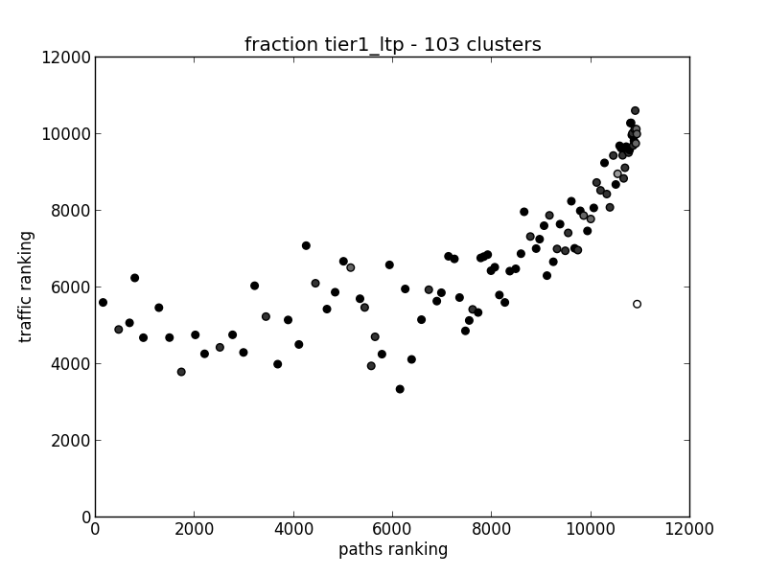
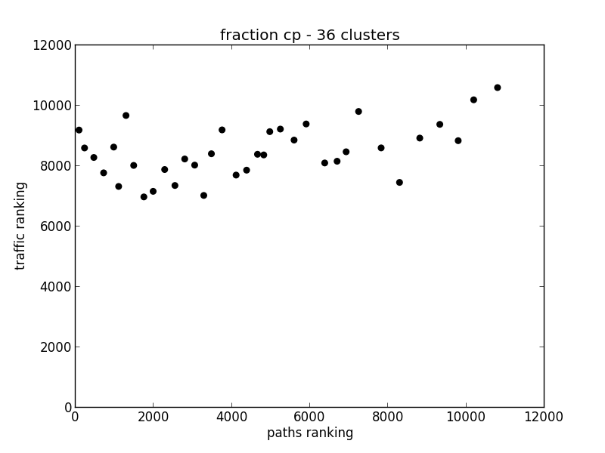
Cluster Breakdown by AS type
Tier1 + LTP – 103 clusters
CP – 36 clusters
Regardless of ranking based on ALTP-frequency… traffic is high -> we are unable to capture it (only see one side of the peering?)

Slide 25
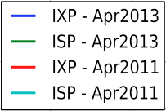
Traffic and popularity – highly skewed
As most popularity measurements, long-tail distributions
Transform to remedy failure of expected normality
Traffic volume vs link-rank for the discovered links
Notes:
Sorted the identified links based on the traffic they carry (using the matrix) and ranked them based on their traffic (using the matrix as well). Following zipf’s law about frequency of words in the english language (http://www.mhnederlof.nl/pareto.html), I then plotted the log-log version of the figure… You can clearly see that if we concentrate on the top links (for all 4 datasets) we see a straight line… pareto/zipf 80/20…
Though we do show that the distribution of the entire traffic matrix is log-normal, for this subset of links, when concentrating on high-traffic links, we observe pareto/zipf distribution… which is consistent… what do you think?

Slide 26
Network Syntax’ metrics
Connectivity (degree centrality) – # of directly linked or neighboring nodes
Control value (linked to clustering coefficient) # of alternative connections each of these neighbors has; measures the degree to which space controls access to its neighbors
Global choice (betweenness centrality) – captures how often each line is used on topologically shortest paths from all lines to all other lines in the system
Integration (a type of normalized closeness centrality) –measures the mean distance between every segment and all other segments in the system
ALTP-frequency - …

Slide 27
Transformations for normality
Transform to remedy failure of expected normality

Slide 28
Strong correlation – proxies for traffic
r² values for all metrics with ISP and IXP
 | IXP |  | ISP
 | Apr 2011 | Apr 2013 | Apr 2011 | Apr 2013
Connectivity | 0.720 | 0.617 | 0.789 | 0.954
Control value | 0.685 | 0.521 | 0.759 | 0.750
Global choice | 0.661 | 0.580 | 0.653 | 0.903
Integration | 0.575 | 0.356 | 0.826 | 0.629
ALTP-frequency | 0.799 | 0.713 | 0.965 | 0.958
Network Syntax centrality metrics are great proxies for traffic

Slide 29
Centrality metrics as proxies for traffic
Correlation between connectivity and ALTP-frequency, and IXP traffic
IXP 2011
IXP 2013

Slide 30
Centrality metrics as proxies for traffic
Correlation between connectivity and ALTP-frequency, and ISP traffic
ISP 2011
ISP 2013

Slide 31
Goodness of fit normalize traffic

Slide 32
IXP 2011

Slide 33
IXP 2013

Slide 34
ISP 2011

Slide 35
ISP 2013

Slide 36
Traffic Prediction Error

Slide 37
Path Ranking IXP2011/2013

Slide 38
BGP – ISP 2011
Connectivity
Control value

Slide 39
BGP – ISP 2011
Global choice
Integration

Slide 40
CAIDA: ALTP-frequency vs. Traffic Volume
ISP 2011
ISP 2013

Slide 41
CAIDA: ALTP-frequency vs. Traffic Volume
IXP 2011
IXP 2013

Slide 42
Traffic Prediction with ALTP-frequency
Using different subsets for computing correlation
~73% in the same order of magnitude
Notes:
Each based on random selection 500 times, median diff.

Slide 43
Path Ranking for ISP 2011/2013
Notes:
r, the linear correlation coefficient, measures the strength and the direction of a linear relationship between two variable
r^2, the coefficient of determination gives the proportion of the variance (fluctuation) of one variable that is predictable from the other variable

